Slide 1
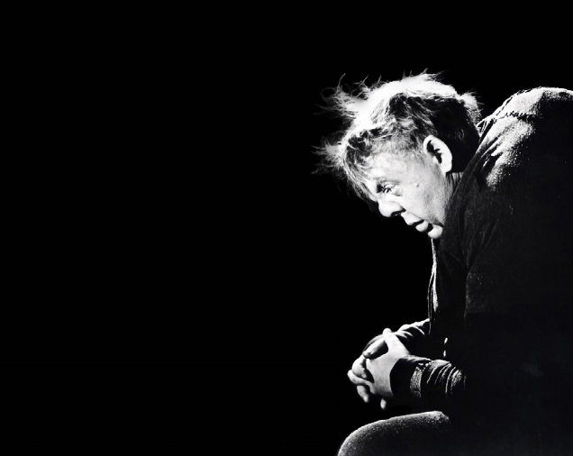
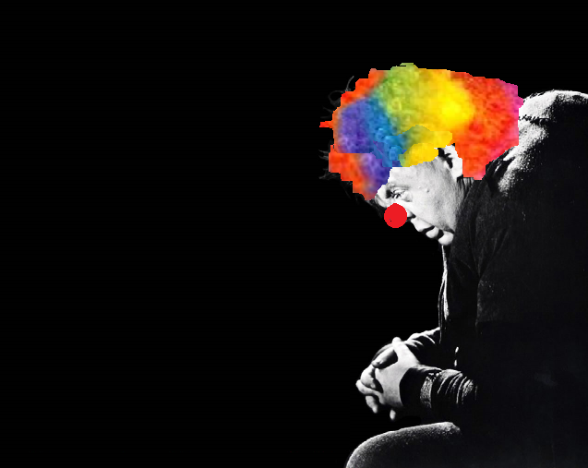
Die hanswors
SJ Pretorius

Slide 2

Titel
The clown/Die hanswors
What are your expectations of a clown?
A Clown is an artist or performer who pretends to be a fool or foolish and acts out or acts up, in order to amuse his audience.
He's a comedian, someone who tries to make you laugh by being funny.
The title is in fact ironic. You will find out why later.

Slide 3
Konteks van gedig
Misvormde(gebreklike) mense is gebruik as hansworse in sirkusse.
Die doel was dat mense vir hulle misvormdheid kan lag…
In hierdie verhalende gedig word die storie van ‘n hanswors-akrobaat met ‘n boggelrug vertel.
A clown acrobat with a hunchback.

Slide 4
Konteks van gedig
Ironic: person who is suppose to make other people laugh, is usually the one with the most pain and the one crying behind closed doors.
The circus is using a disabled person to make people laugh with no consideration of his feelings.

Slide 5
Tema van gedig
Die lyding van die ongelukkiges en die gebreklikes as gevolg van die onmenslikheid van sy medemens.
The suffering of the unlucky and the disabled as a result of cruelty from fellow human beings.
Therefore the tone of the poem is?
Melancholic, heavy-hearted, dejected, moody, depressed. (Swaarmoedig)
It’s a sad story that is being told in the poem.

Slide 6
Wat sien ek wanneer ek na die gedig kyk?
5 strofes
  4 strofes (kwatryne)
  1 strofe (10 versreëls)
‘n Storie word vertel: verhalende gedig.
Leestekens word gebruik in gedig.
Strofes het verskillende rymskemas.

Slide 7
Leestekengebruik in gedig:
:
,
…
“ ”
To emphasize important issues.
Dubbelpunt: Verduideliking volg.
Ellips: Laat jou gedagtes gaan. Make your own conclusion.
Aanhalingstekens: Direkte rede (stories het direkte rede)
Komma: Tussen 2 kommas, inlassin. Gee meer inligting.

Slide 8
Verskillende rymskemas per strofes:
Oor sy afsigtelike boggel en kromheid, het hul hom gekoggel, en bitterder was hul venyn as sy vergroeide ruggraatpyn.
Tussen die diere in ‘n hoek het hy die eensaamheid gesoek: “Met klere wat gedurig gaar is, Wat doen die vent met sy salaris?”
Hy’t maandeliks by die poskantoor ‘n brief gepos of een gelees By die dierkratte, oor en oor: “Sou daar tog êrens iemand wees?”
A A B B C C D D E F E F
Paarrym
Paarrym
Paarrym
Paarrym
Kruisrym

Slide 9
Verskillende rymskemas per strofes:
En daardie ewige reuk en drank: Nie een sou huil as hy bedank, Maar waar hy in die sirkustent Aapagtig teen die firmament, Hoog teen die takelwerk, kon klouter, Die dood uittart, en, klein kabouter, Sy duiwelstreke uithaal onder Dat almal skater vir die wonder, Is hy, boeseer verag, verlate, Nog deur die baas beskou as bate.
Toe het ‘n brief gekom eendag… Hy’t oor die bed gebuk, verblind, Terwyl ‘n boggelvroutjie, sag, Sterwend fluister: “Dankie my kind…”
Paarrym
G G H H I I J J K K L M L M
Paarrym
Paarrym
Paarrym
Paarrym
Kruisrym

Slide 10
Wat sien ek nog as ek na die gedig kyk?
It is in the form of a story, a story has progression ➔ a beginning, middle and end.
  Starts with description of clown. How he looks → perspective of his co-workers.
  Then what the clown feels with regards to the treatment he receives.
  Even though they don’t like him, he is still valuable (exploitable), brings in money.
  Reading about his mother being on her death bed, going to her.

Slide 11
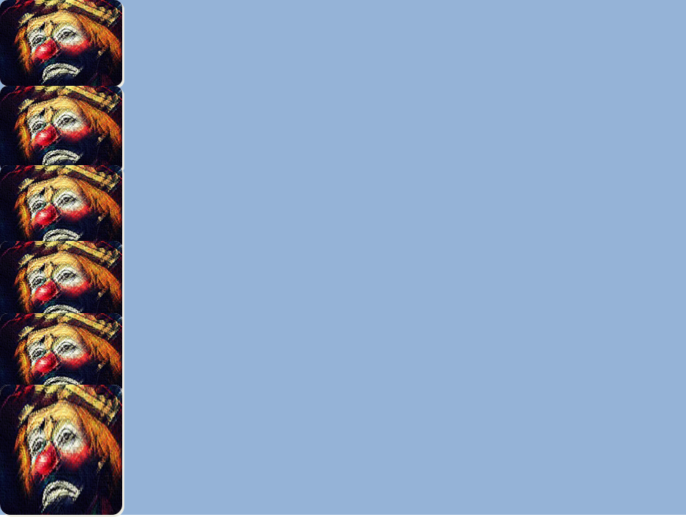
Because of his hideous/ugly hunchback
And crookedness he was teased/mocked
And their venom was more stinging/painful
Than the grown out of shape spinal pain.
Among the animals in the corner
He went in search of the loneliness
"With clothes that is always worn out,
What does this bloke do with his salary?"
Monthly at the post office
He posts a letter or reads one
Next to the animal cages, over and over:
“Would there at least be someone somewhere?”
And the constant smell and alcohol:
No one will cry is he resigns,
But in the circus tent where he,
Like a monkey against the heaven,
High against the tackling, could climb,
Teasing death, and, small dwarf,
Takes out his devilry so under him
Everyone can laugh at this wonder,
It is him, no matter how despised, lonely,
Still seen as asset by the boss.
One day a letter came…
He bent over the bed, blinded,
Whilst a hunchback lady, quietly,
Outs a dying whisper: “Thank you my child…”

Slide 12
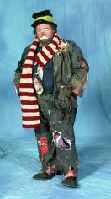
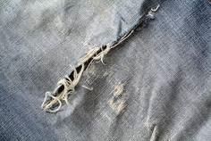
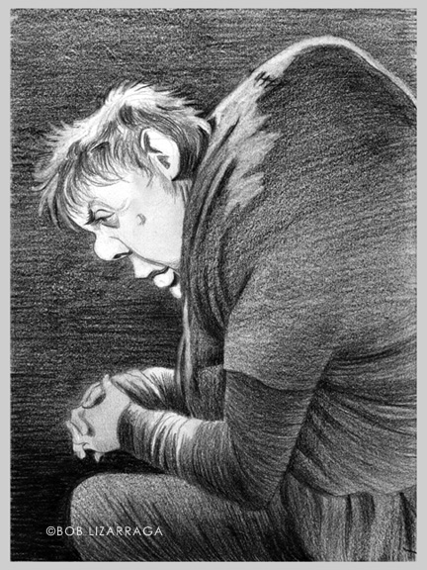
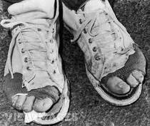
Poet uses senses to describe the clown.
You can form a picture of how he looks and what he does.

Slide 13
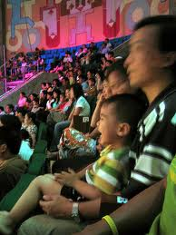
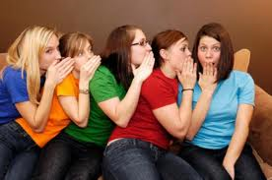
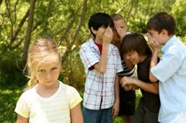
Poet uses senses to describe the clown.
The gossiping of his co-workers, the way they tease him and the way the audience is laughing at his antics.

Slide 14
The clown is being teased because of his hunchback and crookedness.
Strofe 1
Oor sy afsigtelike boggel
en kromheid, het hul hom gekoggel,
en bitterder was hul venyn
as sy vergroeide ruggraatpyn.
He has been humiliated.
Worst than his disability pain?
The hate (venyn) that he is treated with.

Slide 15
Stuur moontlik geld huis toe aan sy moeder.
Strofe 2
He would rather spend his days with the animals: they aren’t as cruel.
Tussen die diere in ‘n hoek
het hy die eensaamheid gesoek:
“Met klere wat gedurig gaar is,
Wat doen die vent met sy salaris?”
Retoriese vraag
Absolute loneliness/absolute eensaamheid van hanswors se bestaan in strofe 2: Description of how he keeps to himself by sitting between the animal cages.

Slide 16
Retoriese vraag
“Met klere wat gedurig gaar is,
Wat doen die vent met sy salaris?”
Rhetorical question: one asked solely to produce an effect or to make a statement, but not expected to receive an answer.
The implication of this question is that the clown’s co-workers think that he wastes his money, because his clothes are always old and worn out.
Do they really know what he does with his money?

Slide 17

Strofe 3
Re-occurring event: Happens every month.
Hy’t maandeliks by die poskantoor
‘n brief gepos of een gelees
By die dierkratte, oor en oor:
“Sou daar tog êrens iemand wees?”
“over and over” the letters are very important to him.

Slide 18
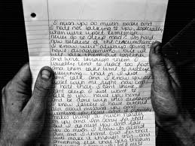

Strofe 3 en 5
Dieselfde onderwerp
Wat is die onderwerp?
Briewe wat maandeliks ontvang en gestuur word.
Tussen wie?
Die hanswors en sy ma. Sy ma het ook ‘n boggelrug.

Slide 19
Strofe 4
En daardie ewige reuk en drank:
Nie een sou huil as hy bedank,
Maar waar hy in die sirkustent
Aapagtig teen die firmament,
Hoog teen die takelwerk, kon klouter,
Die dood uittart, en, klein kabouter,
Sy duiwelstreke uithaal onder
Dat almal skater vir die wonder,
Is hy, hoeseer verag, verlate,
Nog deur die baas beskou as bate.
He is clown that uses his hunchback body as an acrobat high up in the circus tent to do tricks.
Die hanswors se bynaam (Nickname): He is short, stocky and disabled.
BAIE gevaarlik

Slide 20
Stanza 4 very IRONIC
Everyone despises him.
He is very lonely.
YET
The circus still see his use to attract an audience, though not to be his friend.

Slide 21

He receives a letter from his mother, she is on her death bed.
He receives the letter and then goes to her.
Strofe 5
Thank you for the money you send home, that’s why his clothes was worn out.
Toe het ‘n brief gekom eendag…
Hy’t oor die bed gebuk, verblind,
Terwyl ‘n boggelvroutjie, sag,
Sterwend fluister: “Dankie my kind…”
Ooreenkomste tussen nar en boggelvroutjie:
Altwee het ‘n boggelrug (hunchback)
Altwee is klein (vroutjie – verkleining)
Hulle is ma en seun (“my kind”)

Slide 22
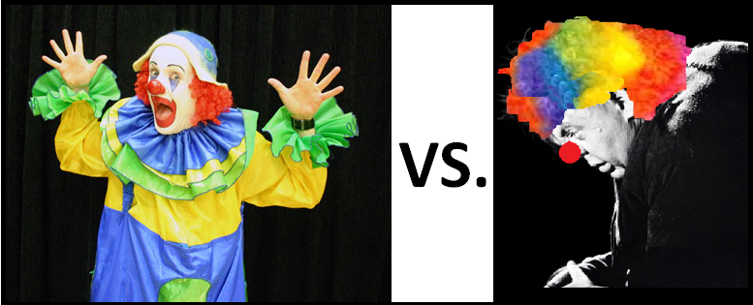
Contrast very evident in poem:
Sy werk as sirkushanswors wat mense moet amuseer.
Glory life of a circus clown entertaining people, getting lots of attention.
Sy hartseer lewe as ‘n eensame man wat met ‘n gebrek lewe.
The disabled clown that lives with his disability alone. His co-workers aren’t friends with him, he is constantly alone and sad.

Slide 23
